Slide 1

Introduction to Android Development
Lecture 7
Teacher:
Mahyar T. Moghaddam (mtmo@mmmi.sdu.dk)
Instructors:
Mikkel Nielsen (mini923@student.sdu.dk)
Asta Knudsen (asknu18@student.sdu.dk)

Slide 2
Agenda
Introduction to Android
Introduction to Kotlin
JetPack Compose
Exercise: Your first native Android app

Slide 3
Introduction to Android

Slide 4
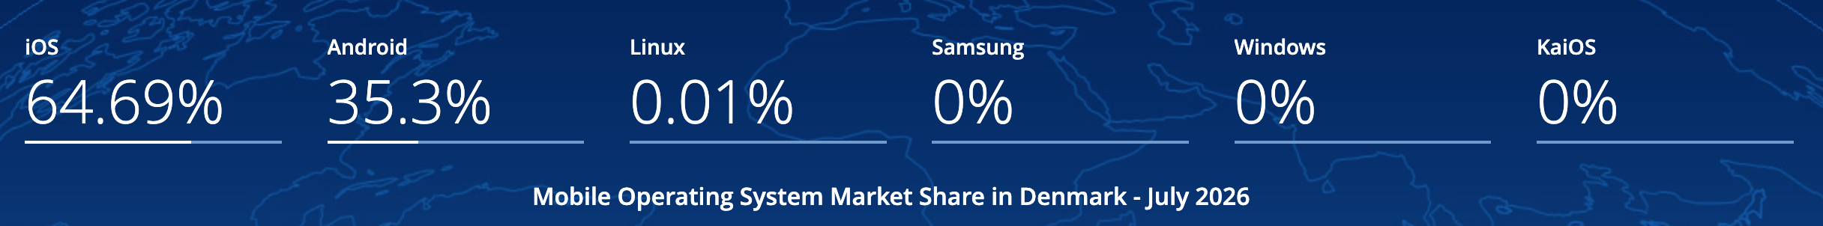
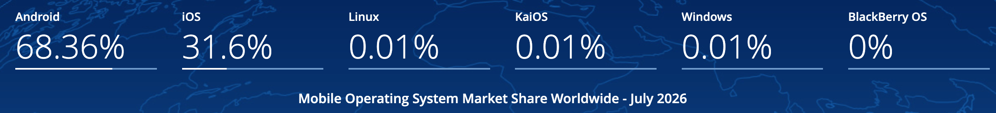
Why create native Android apps?
IOS seems to be dominant
  Especially in western countries
However...
Source

Slide 5
Benefits compared to cross-platform applications
Optimal Performance
  Faster rendering
  Efficient memory usage
Easy Device Feature Access
  Camera, GPS, sensors
  Access OS-level features
User Experience
  Fluid animations
  Platform-specific design guidelines
New Features
  Access new features when they release instead of waiting for Expo to create an integration
Notes:
Faster rendering:
Compose runs directly on Android Runtime (ART)
React Native has more layers (JavaScript -> JSI, Bridge)
Lower latency, better performance in UI-heavy app
Memory Usage:
Compose has no JS runtime on top of Android
Fewer objects, less communication between runtimes
Device access features:
Direct access to Android API’s
No need to wait for community

Slide 6
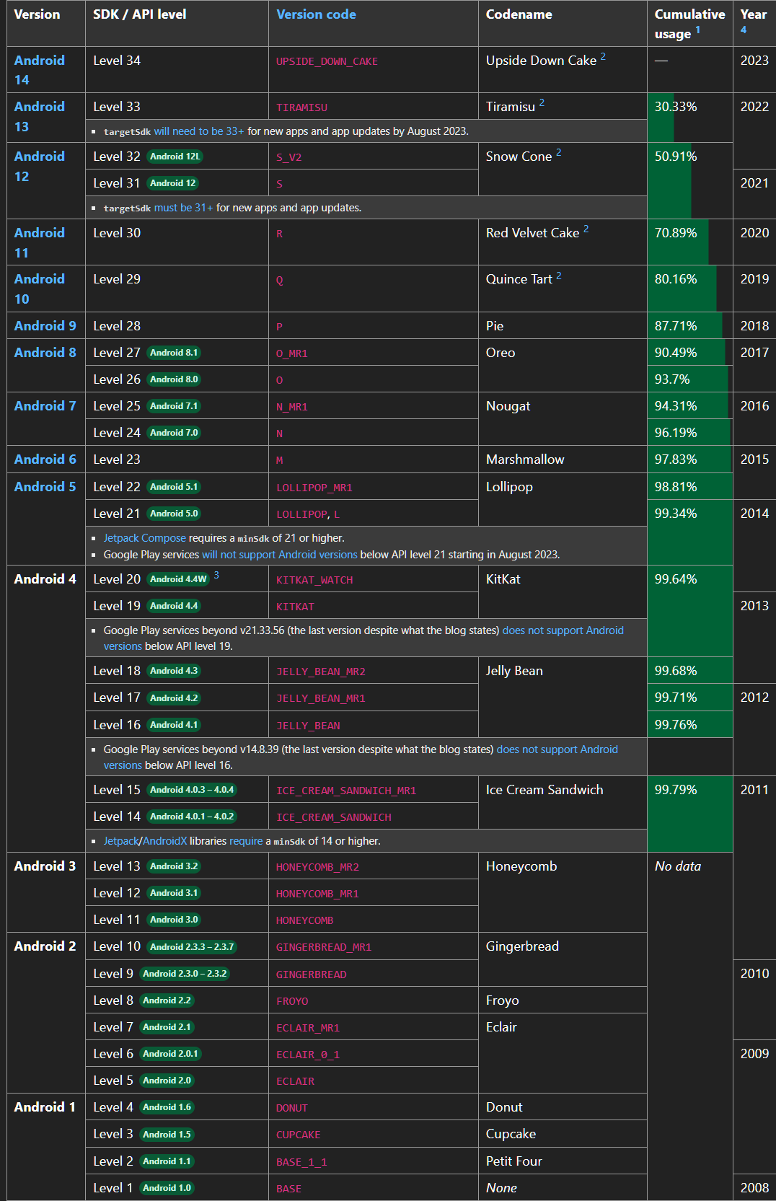
Android versions and API levels
When you develop an Android app, you target an API level (SDK version)
  Android 14 → API 34
  Android 16 → API 36
Devices with a newer SDK can run apps developed for an older SDK, because Android uses forwards compatibility
Further reading: apilevels.com
Notes:
Each Android version has an associated API level.
Targeting API level: tells Android which features (API’s) we expect to be available
Forward compatibility → Google retains compatibility, so older apps work on new versions

Slide 7
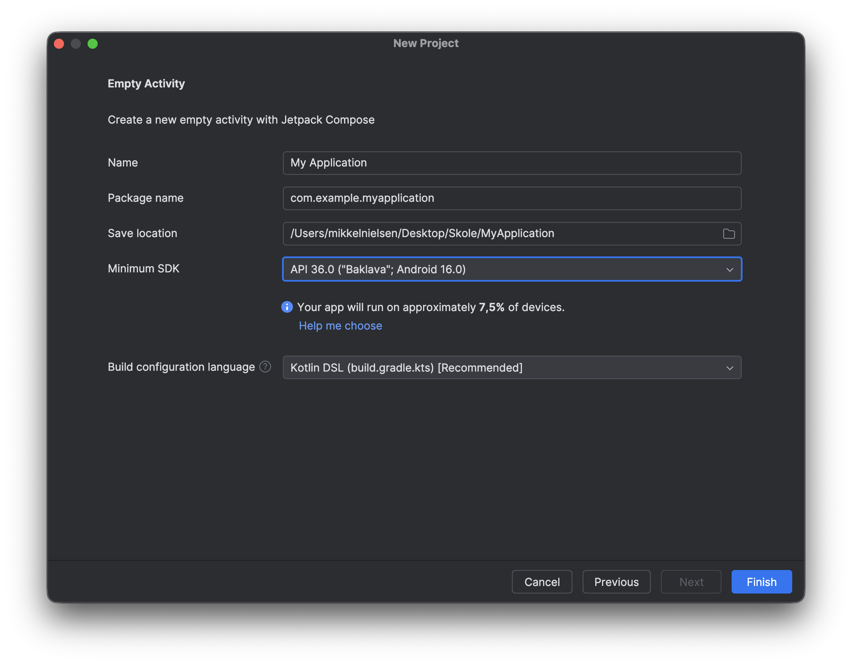

Compatibility – Market Size

Slide 8

Required tools
Android Studio
The IDE for Android app development
Based on IntelliJ IDEA
Includes any tools and helps you install
  SDKs
  Emulators
  Libraries
  that you need to develop for Android
Download page:
https://developer.android.com/studio/install

Slide 9

Kotlin
The official language of Android as of 2017
Developed by JetBrains in 2011 with the purpose of fixing Java’s verbosity and improving developer productivity
Open-sourced in 2012, first stable release in 2016.
Further reading: kotlinlang.org

Slide 10

Kotlin
Key features
Concise syntax: Less boilerplate code than Java
Statically typed: Type-safe but feels dynamic
Null safety: Eliminates the NullPointerException
Data classes: Auto-generate getters/setters and utility methods
Coroutines: Lightweight concurrency for async and parallel tasks
Interoperability
100% compatible with Java: Use existing Java libraries and frameworks seamlessly
You can call Kotlin code from Java, and vice versa
Further reading: kotlinlang.org
Notes:
Concise: Less code to achieve the same result. Since you know C#, it might feel more familiar than for us, who had Java
Statically typed: Variable types are controlled under compilation, so errors are detected before the program runs
Feels dynamic: You don’t have to specify, Kotlin can deduce it by itself
Null safety: Objects can’t be null unless specified with ?
Data classes: Classes that mostly contain data, comes with simple methods
Coroutines: Easy to do async tasks that don’t block the UI

Slide 11
Where to learn Kotlin
You don't need a deep understanding of Kotlin for this course
To get started, follow this basic introduction:
https://kotlinlang.org/docs/kotlin-tour-hello-world.html
The rest you should be able to pick up from the code snippets in the following slides

Slide 12
JetPack Compose

Slide 13

JetPack Compose
What is Jetpack Compose?
  Modern UI toolkit
  Kotlin-first, fully declarative
Why Jetpack Compose?
  Simplified UI creation
  Improved tooling with Android Studio
  A modern alternative to XML-based layouts
Further reading: JetPack Compose
Notes:
UI toolkit:
Google’s tool to build user interfaces for Android
React Native has React Components, Android has Compose
Kotlin-first:
Built for Kotlin
Declarative: UI updates dynamically, can change based on i.e. If conditions and variables
Advantages:
Previews, Live Edit, simpler and less context changes than XML

Slide 14
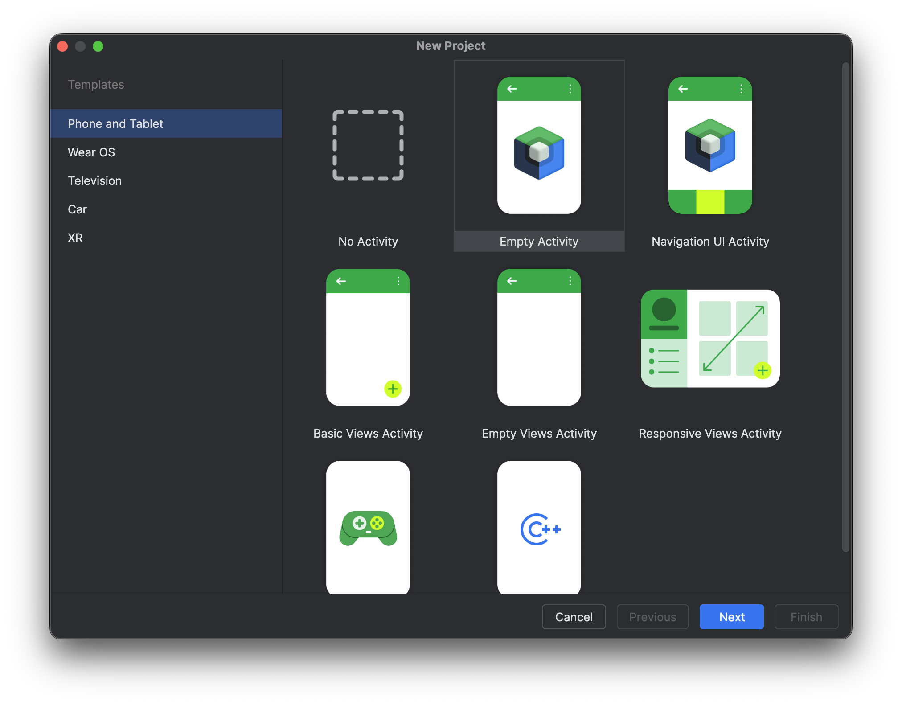
Starting a project with JetPack Compose

Slide 15

Short Exercise
Install Android Studio if you haven't already
Create a new project
  'Empty Activity'
  Give it a name and save location
  Choose minimum SDK (the default should be fine, look at how many devices will be supported)
Try to run the app
  Find 'MainActivity.kt
  Click 'Run App' (. )

Slide 16
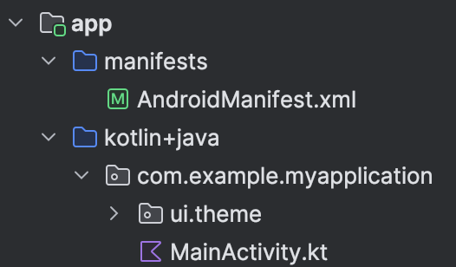
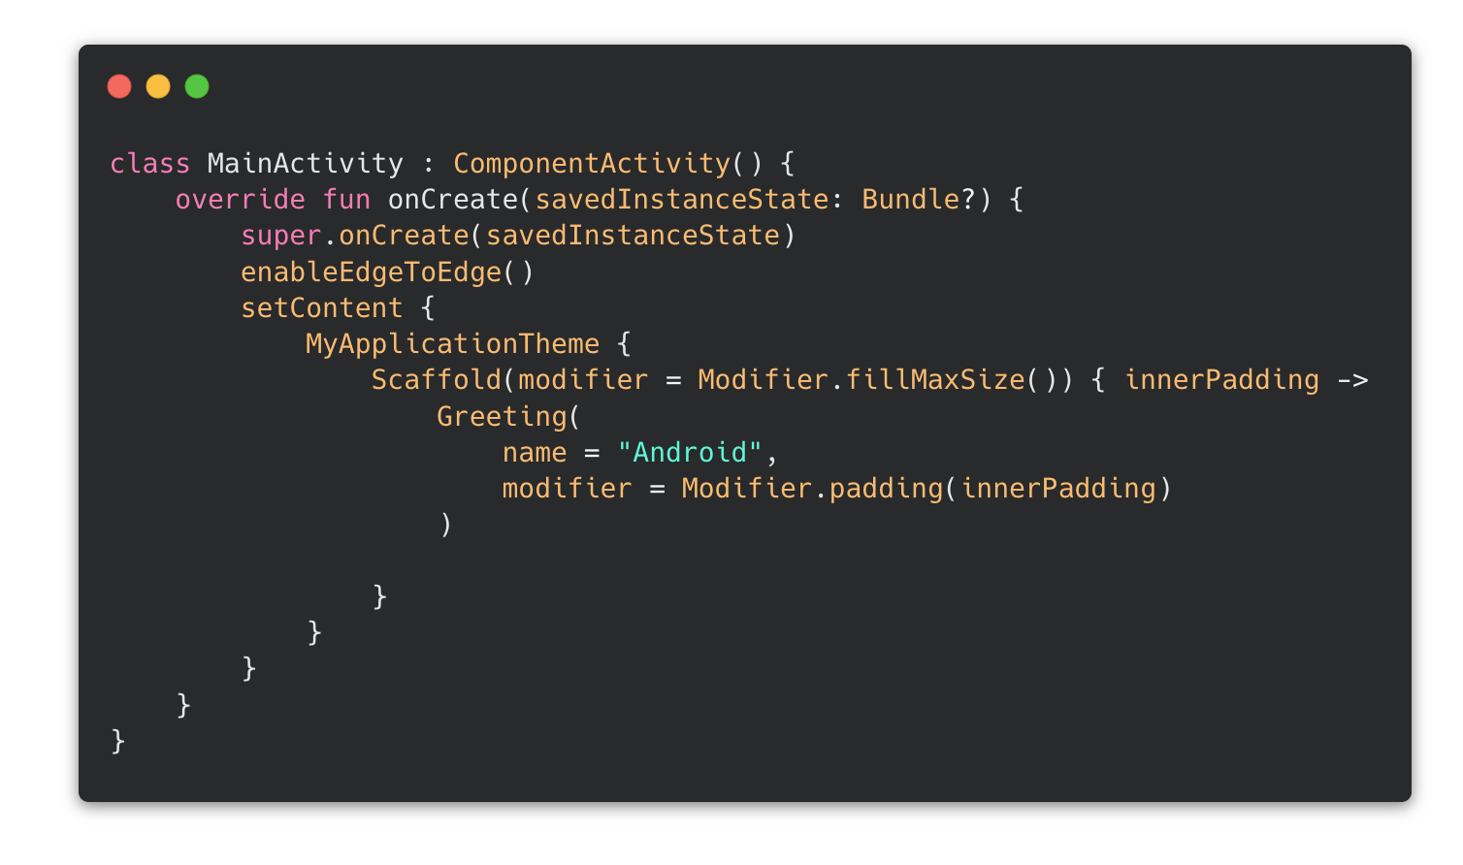
Structure – MainActivity
MainActivity.kt:
  Entry point of the app
  Opened by Android when app is launched
  Functions as the container, in which we place our Compose UI
Note:
  Not important to understand everything here
  Pretty much remains unchanged

Slide 17
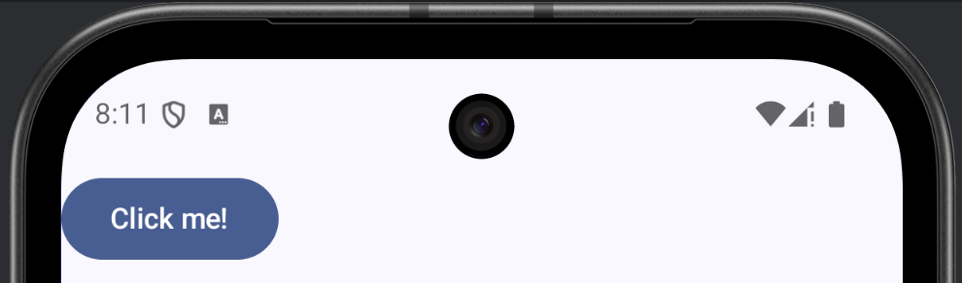
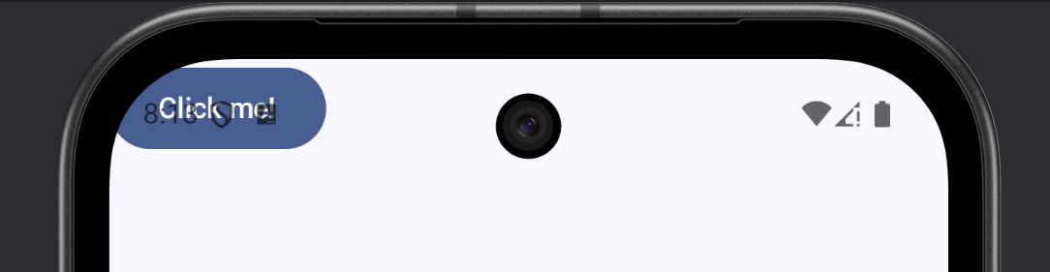
Structure – Scaffold
Standard layout for screen
Automatically calculates how much screen space is occupied by the system
  Passes value as innerPadding
  Used in child components
Also used for top or bottom app bars (for navigation etc.)

Slide 18
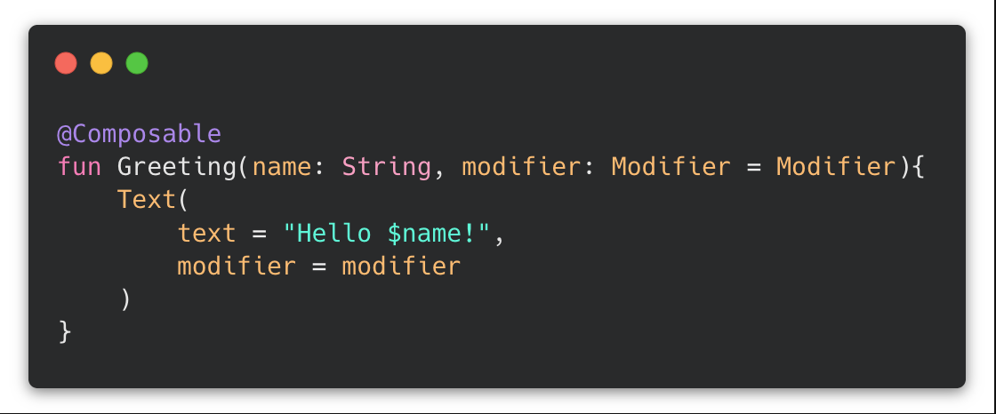
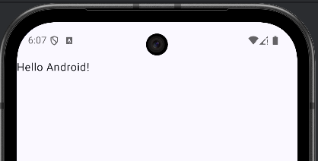
Understanding Composables
Composables are the fundamental building blocks of UI in Jetpack Compose
Composables can contain other (nested) composables
Composables promote reusability
Further reading: Thinking in Compose
Notes:
Composables:
Denoted by @Composable
Reusable components that are used to build the UI

Slide 19
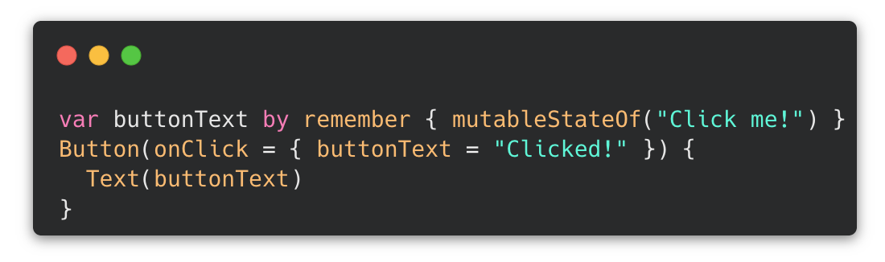
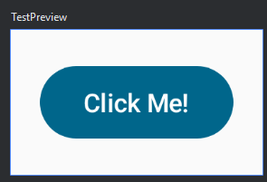
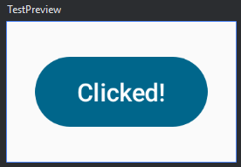
The Button Composable
Buttons can trigger a function when clicked via the onClick property
Buttons can have nested composables, such as text or images
-->
Further reading: Button

Slide 20
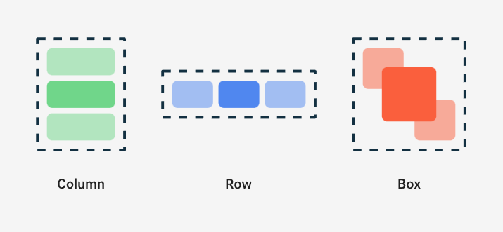
Layout Composables
Further reading: Compose layout basics
Notes:
Asta snakker herfra

Slide 21
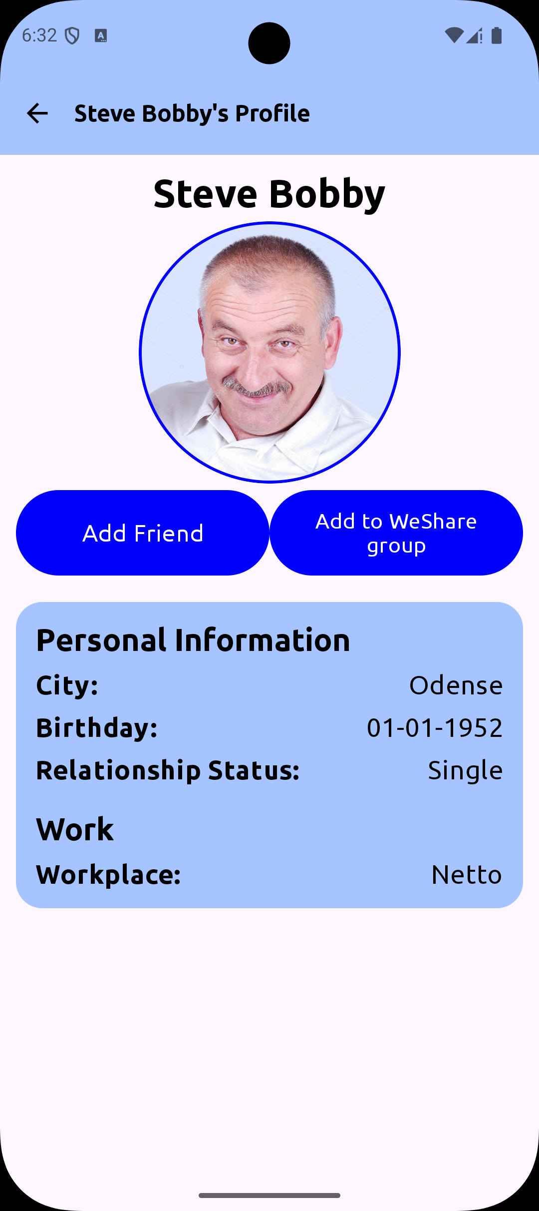
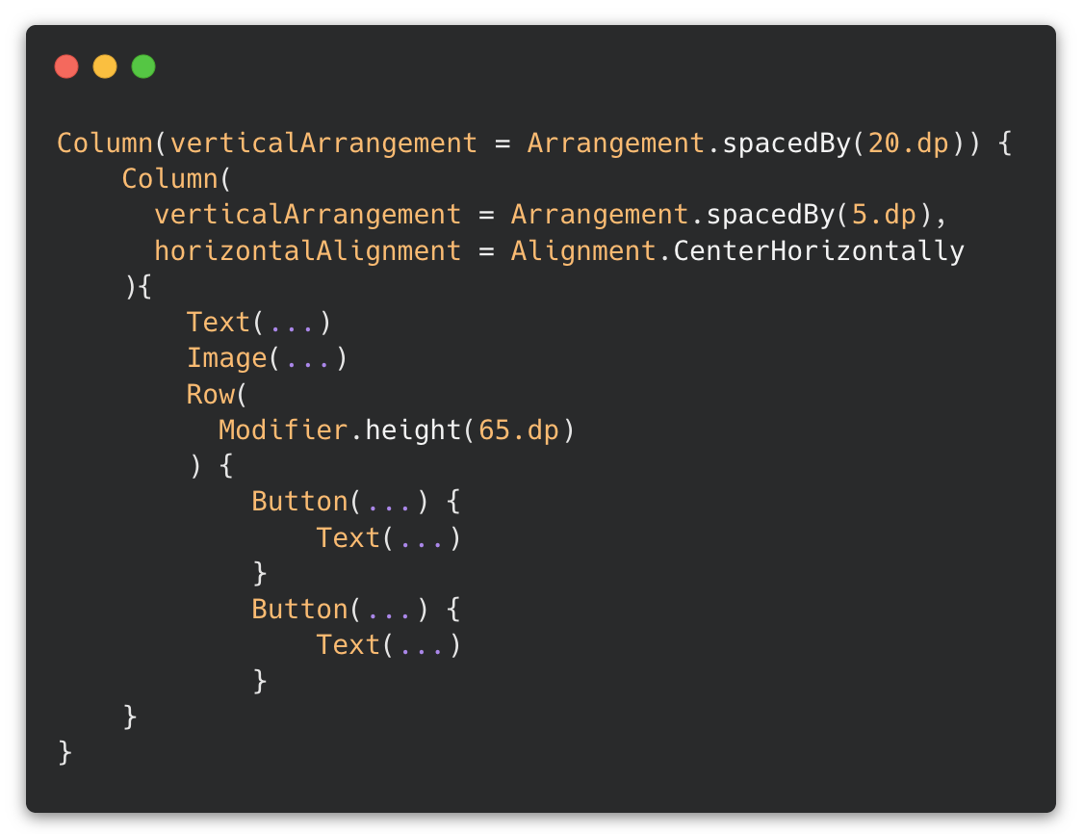
Layout Example

Slide 22
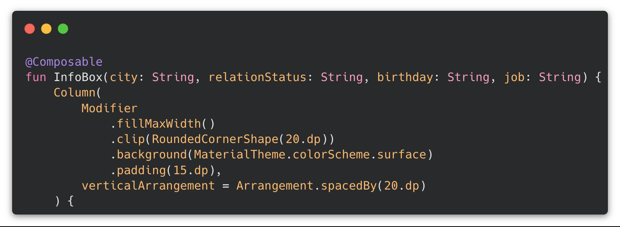
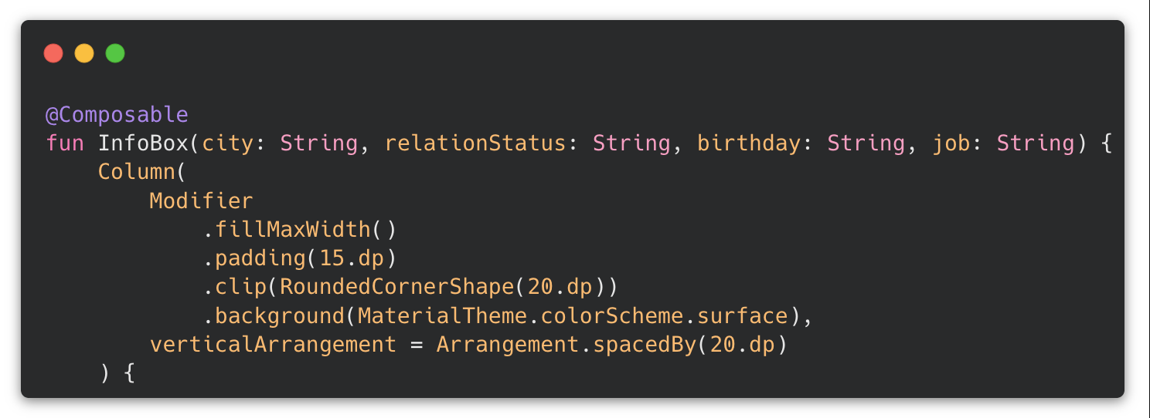
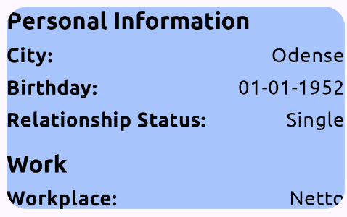
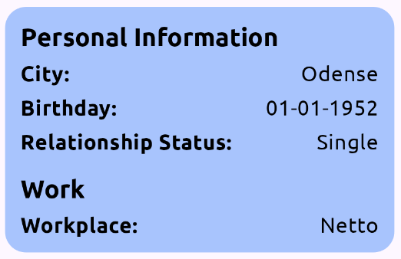
Styling with Modifiers
Modifiers are objects passed to Composables to define their styling
Values are chained left to right, meaning that the order is important
In the example:
  Size is defined first
  Then corners are rounded
  Then background color is applied
  Then padding is applied
  Another order would have changed the result

Slide 23
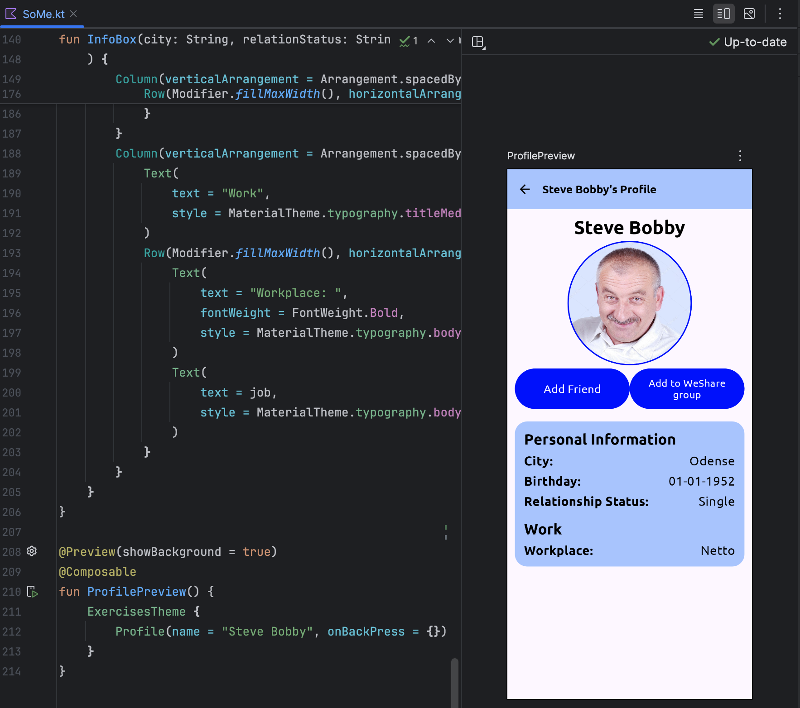
Using Previews
Running an emulator or a real device can be annoying if you just want to fine-tune a piece of your UI
Android Studio lets you preview and interact with Composables directly in the IDE
Click Split or Design to view your previews
Note you have to annotate the composable with @Preview for it to show up
Further reading: Preview your UI with Composable previews
Notes:
Annotate with @Preview
Wrap in Theme to include theme (introduced later)
Makes it so that you don’t need to relaunch the app to see changes

Slide 24
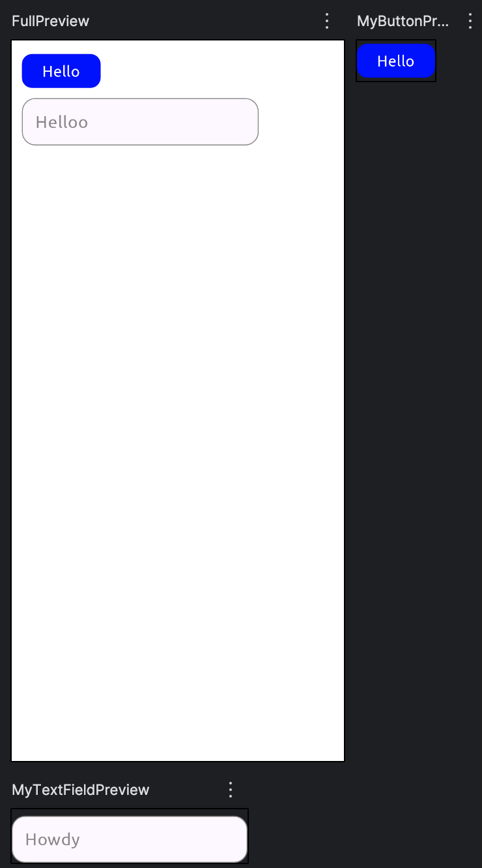
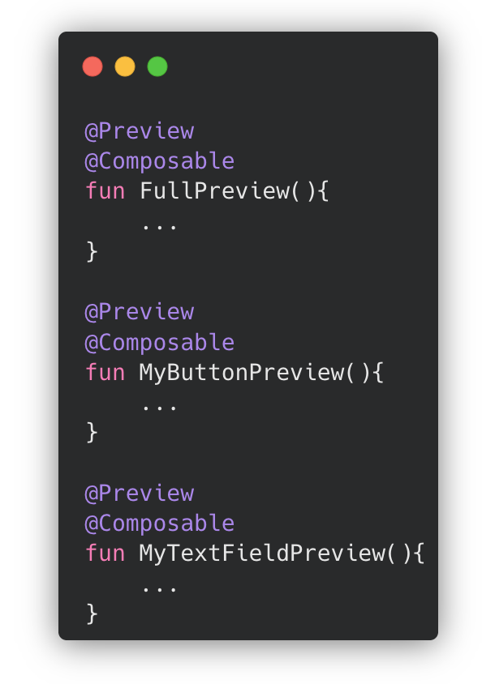
Using Previews efficiently
Provide mock/sample data
Split screens into reusable components
  Reusable and testable UI
Create dedicated previews for individual components
  Easier debugging of individual components
Avoid dependencies on ViewModels or live data
  (we’ll talk more about that later)

Slide 25
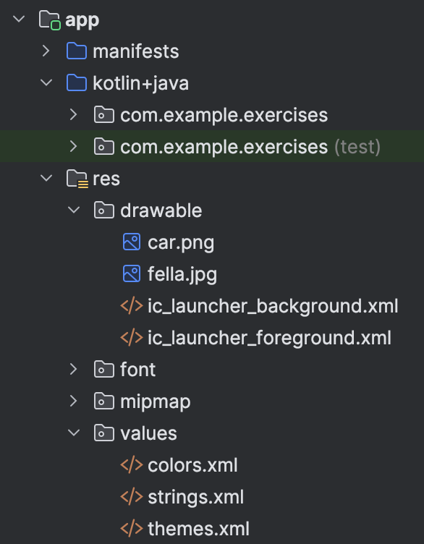
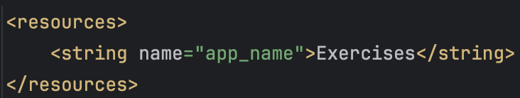
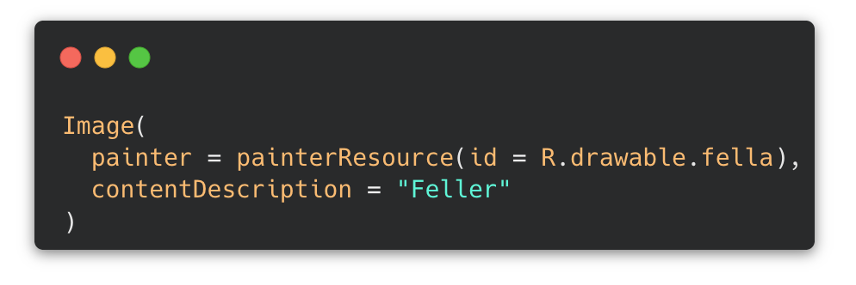
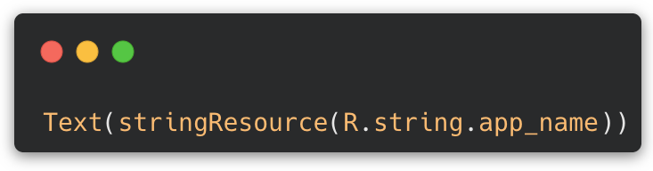
Resource files
Resource files are organized XML files that allow for clean, structured storage of UI-related content, such as string, images, icons and so on
We'll focus on 2 main resources:
  Strings:
    Purpose: Centralized management of text
    Benefits: Easier localization and cleaner code
  Drawables:
    Types: Images (PNG, JPG, SVG), XML-based graphics, and more
Further reading: Resources in Compose

Slide 26
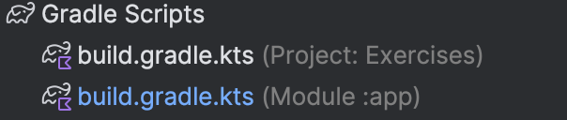
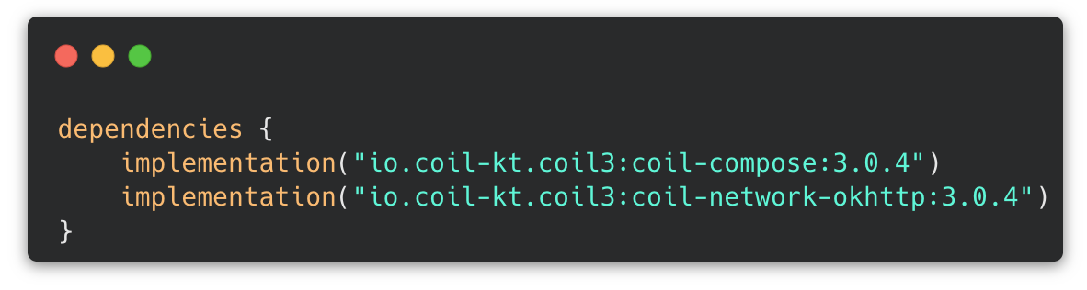
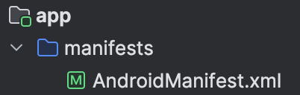
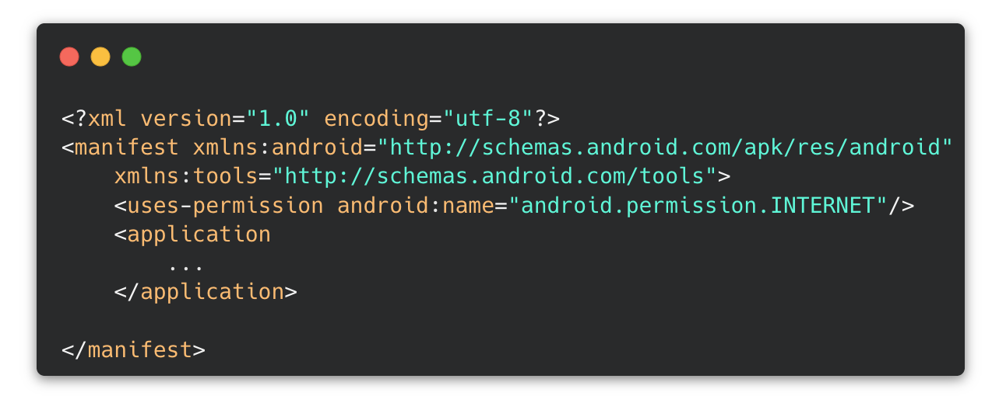
Async Image – Coil
Coil is an external library for loading images from the internet
  Handles caching as well
Dependency in build.gradle.kts
(Module :app)
  Exact versions may vary depending on project configuration
Permission in AndroidManifest.xml
Notes:
Talk about dependency management

Slide 27
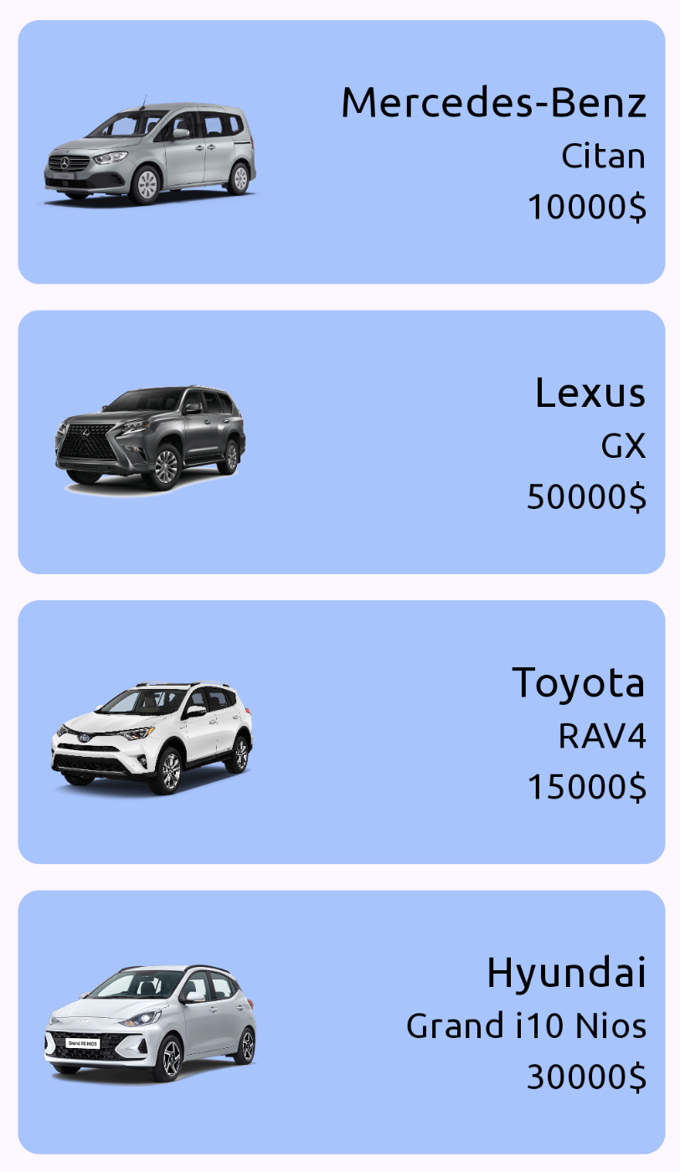
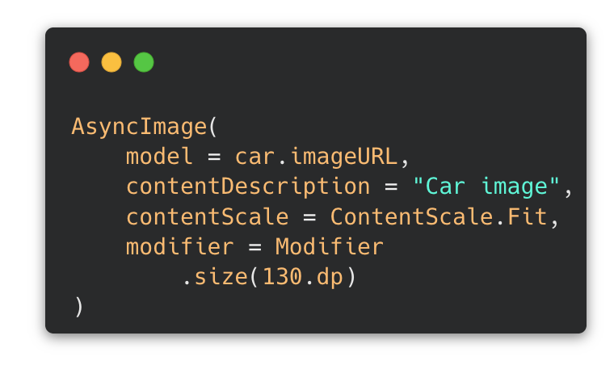
Async Image – Coil
Notes:
Talk about dependency management

Slide 28
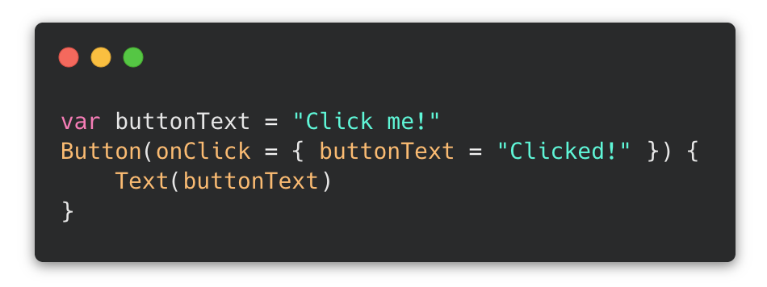
Intro to managing State
No state → Compose does not know that buttonText has changed → UI does not recompose
Solution:
State tells Compose when to update the UI → Changing the state automatically triggers recomposition

Slide 29
Intro to managing State
MutableStateOf:
Creates a state object whose value can change
Remember:
Keeps state during recomposition
Otherwise value would be recreated for each recomposition
By:
Delegates property, allowing for:
  buttonText
  Instead of
  buttonText.value
More on state in the next lecture ☺

Slide 30
Exercise

Slide 31
Exercise – Rest of the day
Create a basic social media profile for a person document via JetPack compose. Your persona should have:
  Name
  Profile picture
  If user of the app is not friends with them → add friend button
  Add to we-share group
Play around with the Composables and explore some of their properties.
  Make the font size of the name larger than the rest of the text
  Choose a good content scale for the profile picture
    Bonus: Import a google font
Use Layout Composables (Column, Row & Box) and Modifiers to create a nice layout

